Slide 1
eSources Summary
Carlos Hernandez-Garcia and Thorsten Kamps
FLS 2012 Workshop
05.03.2012 – 09.03.2012

Slide 2
Acknowledgements
Meeting organizers for ideas and support.
Participants for pithy and provocative discussions, stirring, fresh, out-of-the-box thoughts on electron sources that will eventually allow us to meet the stringent beam and robustness requirements of future light sources.
You.

Slide 3
The charge for eSources as formulated by the Scientific Programme Committee
Identify concepts and technologies that might enable much higher peak or average beam brightness from electron beam sources.
→ What concepts and technologies enable much higher peak or average beam brightness from electron sources? How can we achieve higher brightness?
Consider methods to greatly improve the robustness of operation and to lower the cost of providing electrons.
→ How can we improve the robustness of operation and lower the cost of operation

Slide 4
Questions and themes which came up during the workshop
We need a metric for 6d phase space slice and projected electron beam brightness which can be related to the brightness requirements from the light generation process.
What to we need to do to get the SRF gun working within the parameter space required for future light sources? How can we approach performance levels already achieved with DC and NCRF guns.
Collaborative, inter-disciplinary approach in photocathode R&D proved really succesful in the last couple of years.
Field emission is a common problem to DC, NCRF and SRF alike. Need photocathodes and accelerating structures with low dark current and means to control and mitigate dark current.

Slide 5
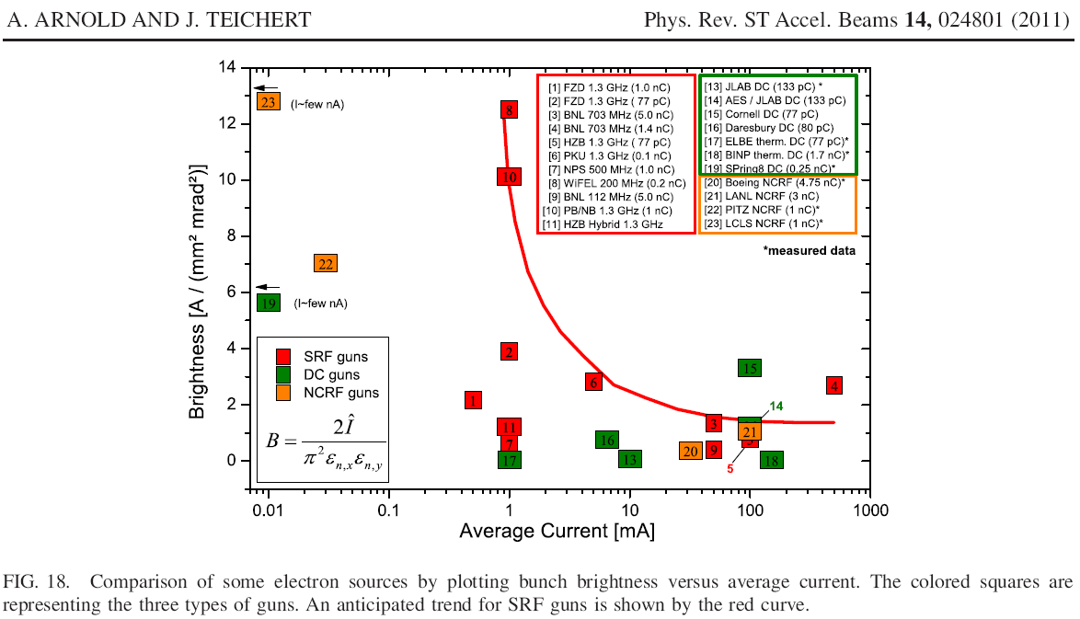
The 6d brightness discussion: How can we translate user photon requirements into electron beam parameters
Kathy Harkay and Boris Militsyn agreed to put together a plot/table with slice (projected) beam brightness vs. peak (average) current as required and realized by various groups.

Slide 6
State of the art and status of current projects with NCRF and SRF guns
Mikhail Krasilnikov (DESY) reported on the results of experimental optimization of an L-Band NCRF photoinjector for FLASH/XFEL facility
The group reports emittance values for a range of bunch charges from 20 pC to 2 nC. Key issues solved recently were the RF phase stability and longitudinal laser pulse shape optimization.
John Corlett (LBNL) introduced the current status of the APEX facility, highly reentrant (QWR) 187 MHz cavity for CW operation. Focus on photoemission studies with different cathodes.
The cavity is now at LBL and RF conditioned. At nominal field level of 19.5 MV/m dark current is 8 uA. Next step is setup of diagnostics beamline.
Boris Militsyn (AsTeC) introduced EBTF/CLARA facility. Main goals is to reach performance limits for NCRF S-Band gun with metallic photocathodes for ultra-short electron pulse production. Potential driver for an FEL class source.

Slide 7
PITZ evolution 2000-2011
XFEL photo injector specs

Slide 8
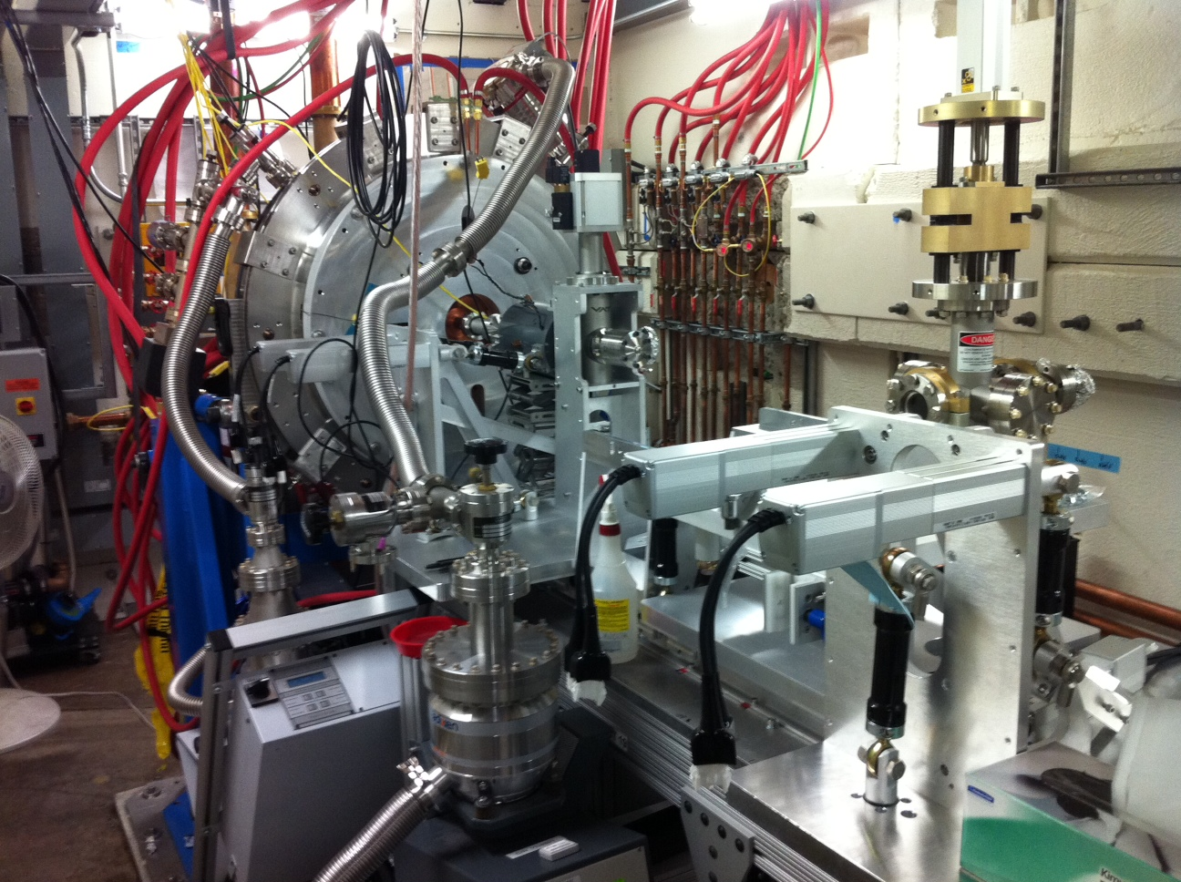
John Corlett (LBNL): APEX gun
high-brightness MHz electron source
APEX cavity is successfully RF conditioned,
December 15: CW mode at nominal power ran for 12,5 hours without faults
Tuning mechanism principle tested
1.2 10-9 Torr achieved with 1 (out of 20) NEG pump and no bake
Notes:
Repetition rate 1 MHz
Charge per bunch from ~10 pC to ~1 nC
Emittance <10⁻⁶ mm-mrad (normalized)
Electric field at the cathode ≥~10 MV/m (space charge emission limit)
Beam energy at the gun exit ≥~500 keV (space charge control)
Bunch length ~100 fs to ~10 ps for handling space charge effects, and for allowing different modes of operation
Compatible with magnetic field control within the gun (emittance exchange and compensation)
10⁻¹¹ Torr vacuum capability (cathode lifetime)
Accommodates a variety of cathode materials

Slide 9
Status of SRF guns for FEL applications
Jochen Teichert (HZDR) reported of status and future plans for the elliptical 3.5 cell 1.3 GHz SRF gun serving multiple user modes at ELBE (IR FEL, Thomson scattering, neutron and positron production).
Measurements of long. and trans. slice parameters using zero phasing and ELBE. Issues with dark current and multipacting. Attempt to counteract MP with DC bias and plan to use with TiN coating.
New cavity, produced by JLAB, showed excellent performance
E_{pk} of 43 MV/m and Q_{o} exceeding 1*10¹⁰.
Bob Legg (JLab/ U Wisconsin) reported on recent results for the WiFEL SRF QWR 199.6 MHz gun. Main goal is to drive a CW FEL facility with ultra-short pulses generated in the blow-out mode. Needs high peak field on cathode. Planning with a load lock to use metallic and semiconductor cathodes. Plug design from ELBE SRF gun.
Cavity was successfully cold-tested at Niowave and is now at Wisconsin. Setup of electron diagnostics and cryomodule assembly is next.

Slide 10
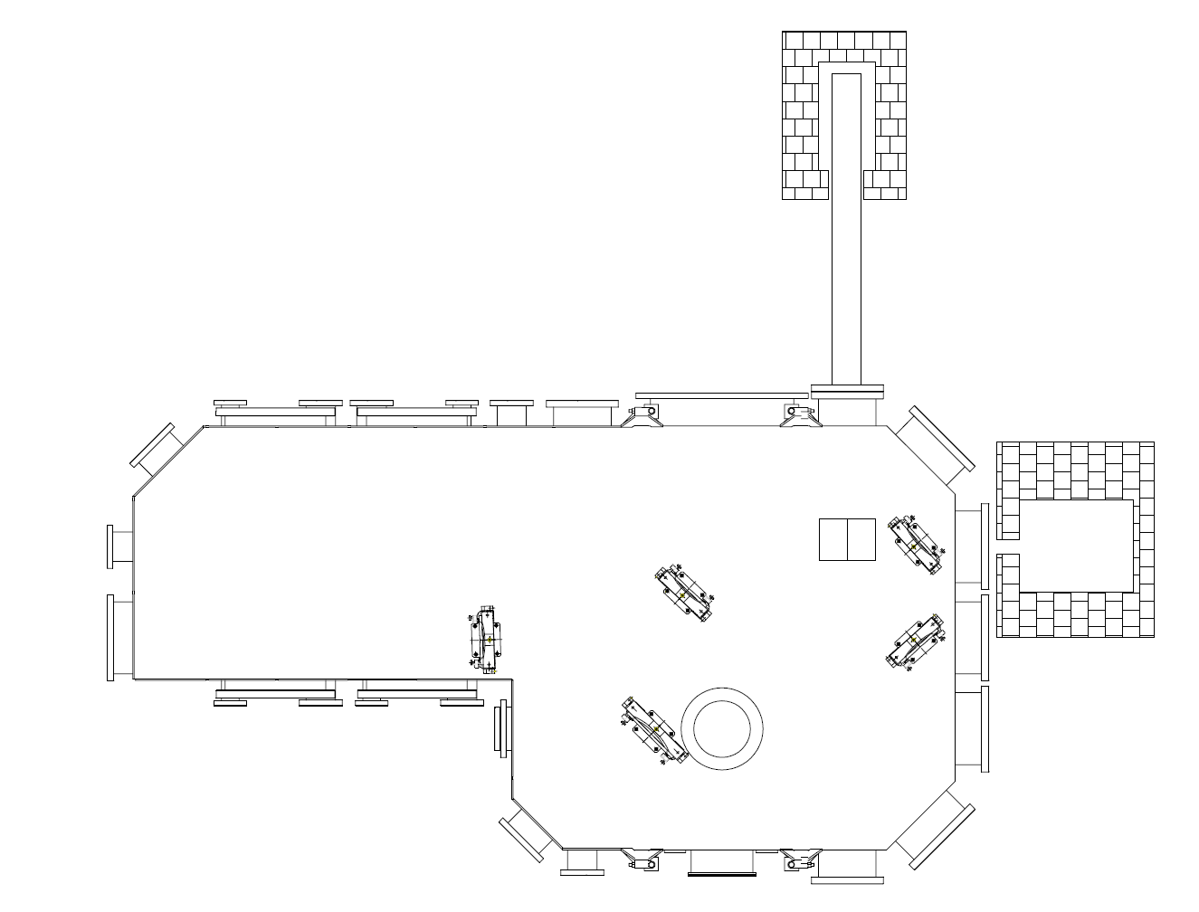
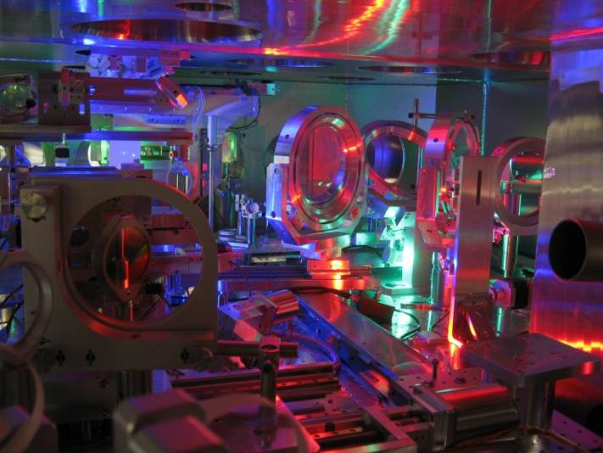
ELBE – Thomson Backscattering (Laser Group)
Production of x-ray photons (some tens keV) in small-scale linear accelerators like ELBE
Head-on collision of ≤150 TW laser pulse and 20 - 30 MeV electron bunch of ELBE linac
Electrons are driven by the electric ﬁeld of the laser pulse to an oscillatory motion (undulator)
emit Doppler up-shifted radiation at an angular frequency of ω_{sc}=(10-20 keV)/h (for ELBE)
Al beamdump
Pb shielding
dipole magnet
Electron beam
from ELBE
Quadrupole triplet
Cam
x-rays
Off-axis
parabola
(F/#=30)
Laser beam
from DRACO laser
vacuum chamber
A.D. Debus et al., Appl Phys B (2010) 100: 61–76
Notes:
At the end of my talk i will present the results of our first user experiment driven by the srf-gun – the thomson backscattering
The idea of thomson is the x-ray production with some tens of keV in small scale acc like ELBE
Therefore one uses the head on collision of TW laser pulse and 20-30MeV bunches from ELBE
If both hits each other, Electrons are driven by the electric ﬁeld of the laser pulse to an oscillatory motion
And emit Doppler up-shifted radiation
10

Slide 11
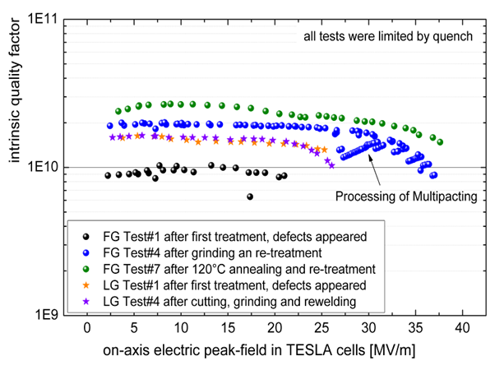
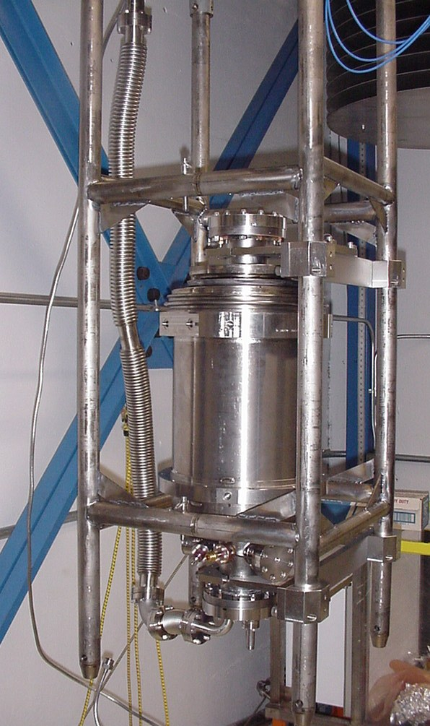
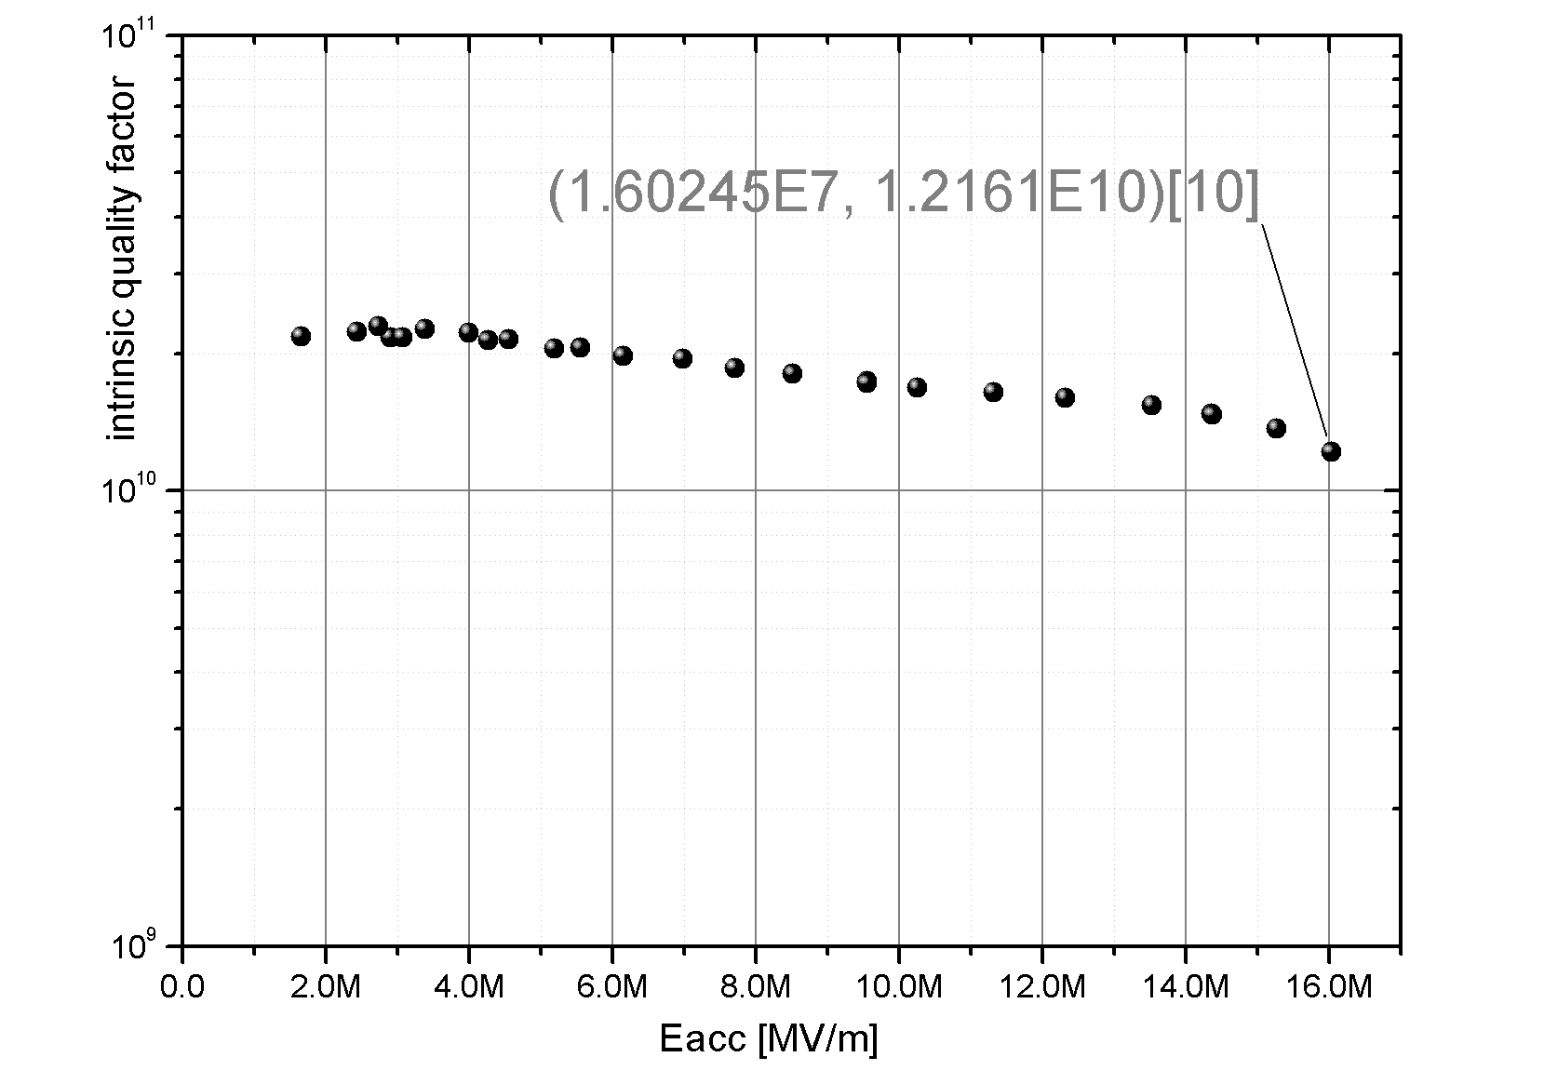
FUTURE - New cavities with high gradient
JLAB_FG_Cavity
43 MV/m peak field
in vertical test @ JLab
after He tank welding
many thanks to Peter Kneisel
and his co-oworkers at JLab

Slide 12
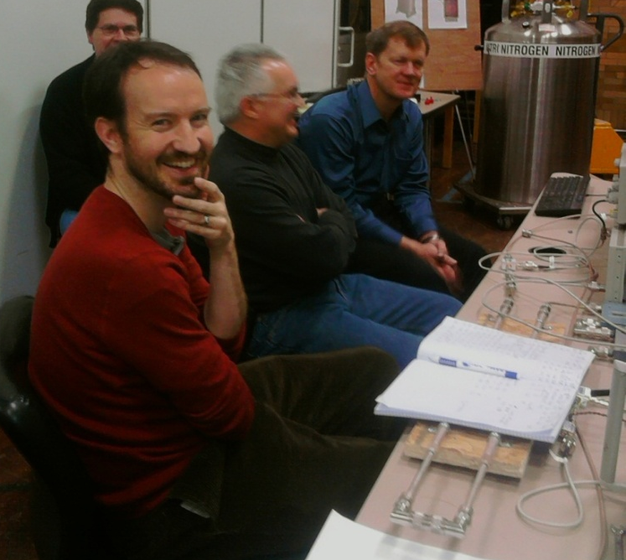
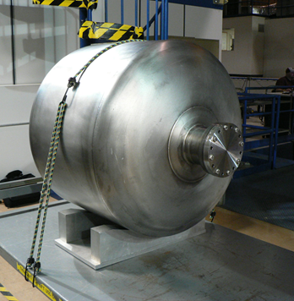
Bob Legg (JLab/U Wisconsin): Cold Test of Cavity at Niowave Completed and Installation into He Vessel Under Way
R/Q = 147 Ω
Gap in the data here shows conditioning progress from one run to the next.
Low field Q₀ of 3 10⁹ , as predicted by modeling
Gradients in 10 MV/m range obtained, limited by test configuration (limited RF power, test coupler, and pumping)
The cavity showed initial multipactor and field emission but both continued to process throughout the test
Field is expected to substantially improve with continued processing after final assembly at Wisconsin

Slide 13
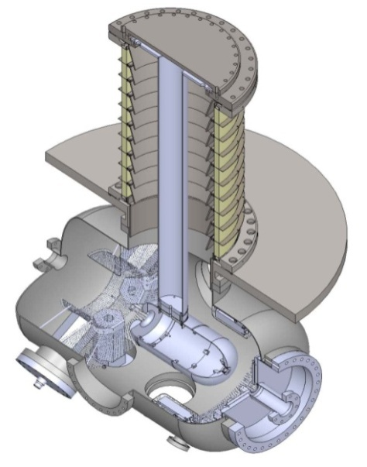
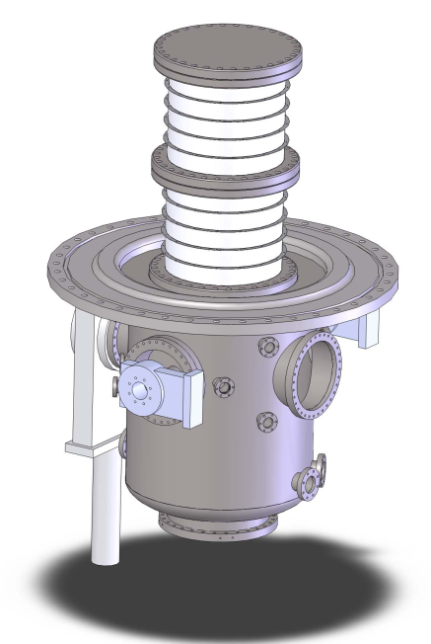
Status of DC 500 kV gun systems
JAEA 1st Gun
HV test with a stem electrode: 500kV (510kV) for 8 hours without any discharge
Beam generation at 300kV
Scheduled to be installed by Oct. 2012 to cERL beamline.
KEK 2nd Gun
Titanium chamber and ceramic tube were fabricated.
Now modifying HV power supply.
Out gassing rate and pumping speed of extreme high vacuum system were measured.
See N. Nishimori-san’s talk, FLS2012.
JAEA 1st Gun
KEK 2nd Gun
Notes:
JAEA 1st gun achieve 500 kV operation and beam generatin at 300 kV.
We schedule installation of this gun by Oct. 2012 to cERL beamline.
For KEK 2nd gun,

Slide 14
Summary and Outlook
JAEA 500kV gun status
Scheduled to be installed by Oct. 2012
HV test with a stem electrode: 510kV (500kV) for 8 hours without any discharge after removal of FE site by current conditioning for 50 hours
HV test with a cathode electrode: 440kV (430kV) for 8 hours without any discharge. FE site cannot be removed by current conditioning so far.
Vacuum: 8x10⁻¹⁰ [Pa] N₂ equivalent in HV chamber with HV on
Beam generation at 300kV
Outlook
Repeated wiping with NEG reactivation might be a solution to 500kV
Gas conditioning with monitoring HVPS current carefully
Beam generation at > 400kV

Slide 15
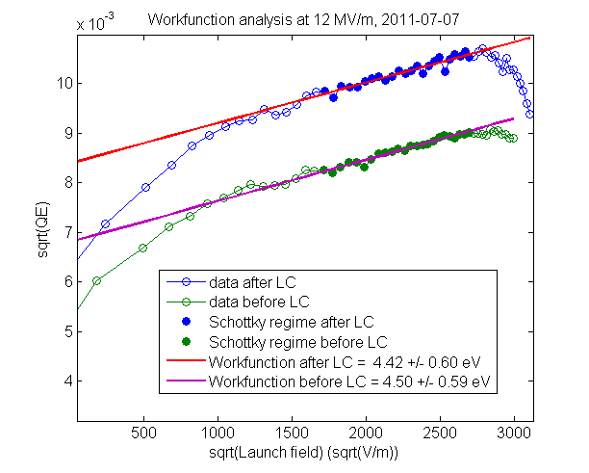
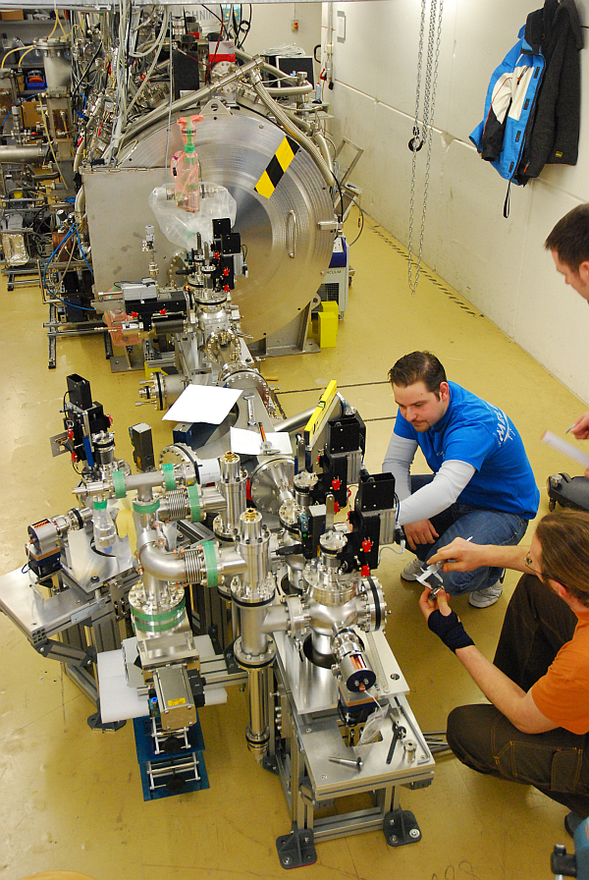
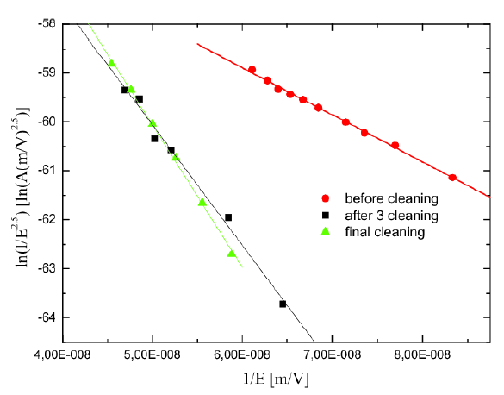
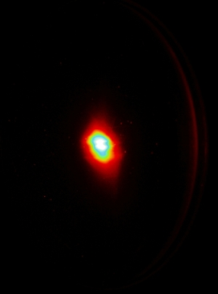
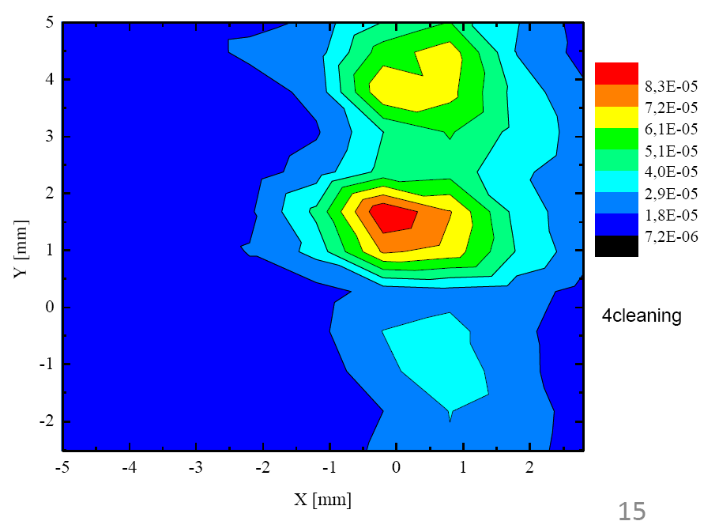
The goal is to develop a photoinjector with characteristics within the parameter envelope of an ERL for a lightsource
Gun0
Succesful run with a SRF gun with SC Pb cathode.
First beam in April 2011.
New cavity with cathode plug and improved Pb coating procedure showed gradient of 54 MV/m.
Gun1
Setup of cathode preparation lab.
Kick off cryomodule design.
Iterate on gun cavity.
Test and improve cathode plug.
Start planning setup of Gunlab.

Slide 16
Session on electron sources for ultra-fast electron diffraction
Pietro Musumeci (UCLA): RF photoinjector based FRED: “Poor man’s X-FEL”, a new technique for ultrafast structural dynamics with sub-100 fs temporal resolution, single shot capability.
Allows to study Irreversible ultrafast transformations with different samples (thickness, gas phase, etc.). Great opportunity for cross-fertilization on advanced longitudinal beam diagnostics, like sub-pC charge detection and sub-50 nm beam emittance measurements.
Cathode research: Surface plasmon assisted photoemission in RF photoinjectors.

Slide 17
Session on electron sources for ultra-fast electron diffraction
Bas van der Geer (Pulsar/U Eindhoven): Laser-cooled sources
Very promising new development
Experimental results match (GPT) predictions
Bright future
Higher brightness
Requires new simulation techniques for the calculation of all pair-wise Coulomb interactions
Such as implemented in GPT where we can now track >1M particles including all pair-wise interactions
Produces phase-space distributions with divergent rms values

Slide 18
Kathy Harky (ANL) Ultra-bright Designer Photocathodes
Ultra-bright photocathodes are a key technology for the development of future light sources.
Two approaches are applicable, depending on time-frame:
Near-term: Optimize the synthesis and performance of long-known photocathodes such as Cs₂Te, CsKSb, GaAs (ANL, ASTeC, BNL, HFZD, INFN, JLab, LBNL, PITZ, et al.)
Mid-to-far-term: Explore novel crystal systems numerically and optimize ("design") their properties, or nano-engineer surfaces, or other novel idea (ANL, ASTeC, BNL, Eindhoven, Jlab, LBNL, SLAC, UCLA, Vanderbilt, et al.).
Properties to design or tune include:
Intrinisic emittance
Workfunction
QE
Reliability, robustness (vacuum, E-field, field emission)
K. Harkay Ultra-bright designer photocathodes FLS2012 Mar 2012

Slide 19
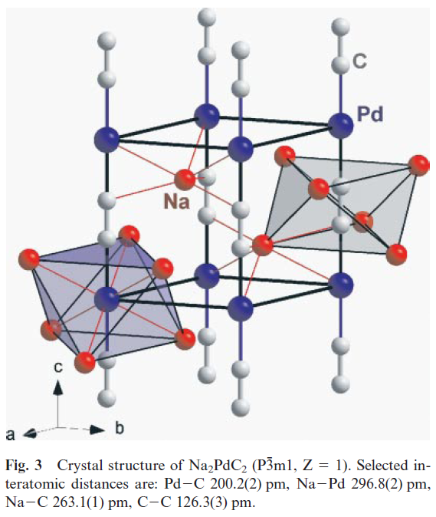
A₂MC₂ Type Ternary Acetylides
Unique 1D substructures, where A=alkali metal and M=transition metal or metalloid.
All known A₂MC₂ are colored semiconductors with 2.1-2.8 eV direct bandgaps.
Synthesized so far: M∈[Pt,Pd] and A∈[Na,K,Rb,Cs].
We investigated acetylated Cs₂Te, where M=Te and A=Cs
Completely new class of materials for photophysics and low-workfunction applications (e.g., field-emission displays). Provisional patent application filed: K. Nemeth et al.
[Fig: U. Ruschewitz, Z. Anorg. Allg. Chem. 632, 705, 2006.]
K. Harkay Ultra-bright designer photocathodes FLS2012 Mar 2012

Slide 20
Wayne Hess (PNNL):
Surface Science for Cathode Development
Photoemission from Hybrid Materials
Multilayer film of CsBr show greatly enhanced quantum efficiency
Quantum Efficiency Enhancement
at 4.8 eV
Clean Coated Factor
Cu 5.0 x10⁻⁵ 3.0 x10⁻³ 50
Nb 6.4 x10⁻⁷ 5.0 x10⁻⁴ 800
Maldonado et al. J. Appl. Phys. 107, 013106
(2010); Microelectron. Eng. 86, 529 (2009)
Metal
Dielectric
Enhancement process requires
photoactivation
E₀
e-
ΔΦ
CB
Φ
E_{CBM}
hν ~ 3.5 eV
CsBr film
5 to 25 nm
E_{F}
e-
+
F center
band
Metal
substrate
VB
E_{VBM}
JR Maldonado et al. Microelectronic Engineering
86, (2009) 529 & references therein
20

Slide 21
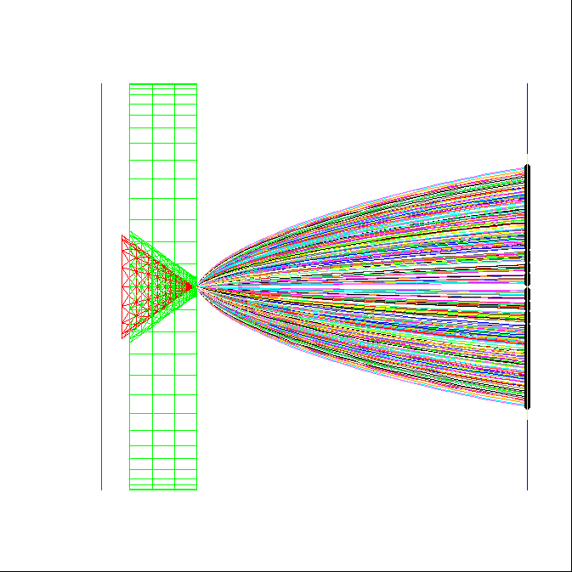
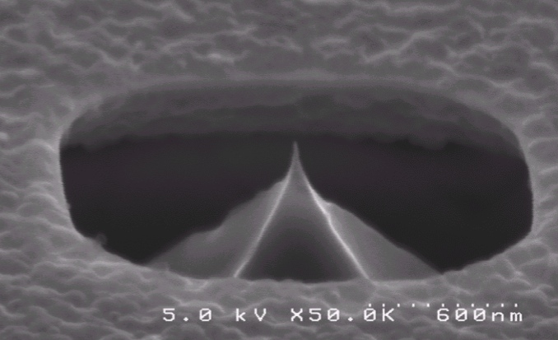
Individual field emitters provide electron beams with exquisite brightness
Diamond tip and self-aligned gate comprise monolithic structure
Tip radius ~6 nm
Tip current is switched by ~70 V gate bias
Measured current ~ 15 μA
Simulations indicate normalized emittance ~ 1.3 nm
Mostly spherical aberration
Heisenberg limit ~ 1 pm possible from ungated tip
Bo Choi, Jonathan Jarvis, and Charles Brau

Slide 22
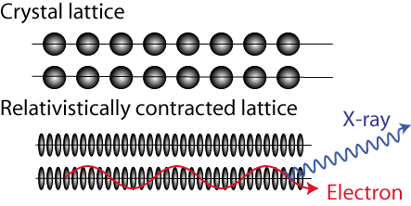
Channeling radiation from tightly focused electrons produces brilliant, hard X-rays
MeV electrons in crystals produce channeling radiation
Theory and experiments are well established
Hard x-ray emission possible from a diamond chip
70-keV photons from 35-MeV electrons
Requires modest rf linac
High spectral brilliance requires exquisite electron beam emittance
10¹² ph/s/μm²/0.1%BW
Requires
200-nA average current
1-nm normalized emittance
40-nm focal spot on diamond
These parameters have never been explored in an rf linac
Propose new type cathode
Explore emittance growth
Theory/simulation
Experiment
Bo Choi, Jonathan Jarvis, and Charles Brau
Notes:
Dresden group showed everything agreed with theory.

Slide 23
T. Quast (HZB): Reality and Future Directions for Spatio-Temporal Laser Pulse Shaping
Summary
transversal pulse shaping has to be done carefully
with advanced pulse shaping the beam transport becomes an issue (dont mess it up..)
advanced and controlled pulse stacking setup for flat top laser pulses work nicely
first steps into 3d ellipsoidal shaping are done – further exploration needed
Remarks
Overall performance of a gun largely depends on careful technical implementation of the Ph. Cath Laser
Stable laser parameters improve the overall performance
Put more emphasis on laser diagnostic and feedback
More complicated shaping schemes, utilizing nonlinear effects causes unwanted coupling of parameters
Less degrees of freedom
Potential source of instability
Is it worth it ?

Slide 24
Session on unwanted beam: observations and diagnostics
Jochen Teichert (HZDR): Assuming an unwanted beam of < 1 µA in CW accelerators with SRF guns. There will be a need for photo cathodes with low dark current.
Proper handling to prevent dust particles and damage
Plug materials and roughness
Photo layer properties (roughness, homogeneity, thickness, high work function, crystal size and structure, multi-layer design, post-preparation treatment (ions, heating), pre-conditioning).
Pavel Evtushenko (JLab) described the route to beam diagnostics with large dynamic range. Studies of halo with this type of diagnostics will lead to higher order beam optics for halo manipulation, independent of the core beam.

Slide 25
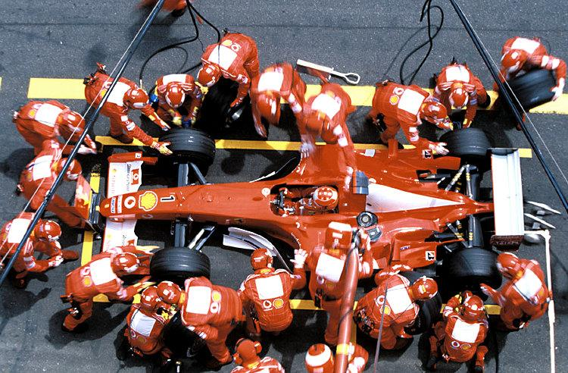
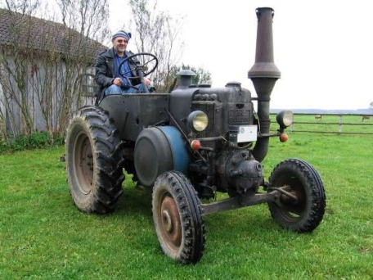
Continuing worldwide mulit-disciplinary efforts towards developing eSources with …
… customized high performance…
… and high reliability.

